Slide 1

FINAL YEAR PROJECT PRESENTATION
ON
ONLINE KABADI WEBSITE
DEPARTMENT OF COMPUTER SCIENCE & ENGINEERING
MGM’s College of Engineering & Technology, Noida
August, 2021

Slide 2
Submitted By
Paras Jain (1709510025)
Adesh Singh (1709510005)
Gagan Singh Dhami (1709510013)
Rishabh Choudhary (1709510032)

Slide 3
INTRODUCTION
This report contains detail description about the web application OnlineKabadi which is used by the customer in order to sell scrap online using our application.
In India nowadays, if someone has to sell their scrap, then they have to wait for ragman to come and buy those scraps, and sometimes they don’t offer a good price for the scraps

Slide 4
PURPOSE
Purpose of this project is to save time for both seller and buyer. In order to build a trustful communication between ragman and seller we have created this application which is providing an online platform for both buyer and seller.
Selling scrap offline is very time consuming and sometimes leads to wastage of time for both customer and ragman. Till now communication between buyer and seller is not good which sometime leads to conflict.

Slide 5
SCOPE
Sometimes finding ragman is not an easy task for customers. So customer has to wait for hours. So this online platform will help customer to reach directly to ragman by following only three simple steps.
Image of every ragman in India very doubtful and they don’t allow ragman to enter their houses. They treat them as they are part of any thief community.
Today's time everything from clothing to food is available online but still one sector is unorganized i.e., scrap industry.
Scope of our application is very simple and customer friendly and created using simple technology and provide user friendly user interface.

Slide 6
OBJECTIVES
Fair Labor: In OnlineKabadi.in, our executives are well educated, polite, friendly, and driven by a passion for customer service. They are well trained in work ethics and customer relations.
Accurate Weight: Customers who sell their scrap at OnlineKabadi can rely upon to get a trustworthy price for all the scrap materials sold. To keep our customer's peace of mind we use a superior quality digital weighing machine.
Instant Payment: OnlineKabadi offers comfort and flexibility to our customers by providing doorstep pickup service and also Instant payment for their scrap.
Convenience: We have a dedicated pick-up service to collect your scrap materials directly from your doorstep and on a scheduled day and time. For us, the user or customer convenience is very important.

Slide 7
TECHNOLOGIES USED
JAVASCRIPT - JavaScript, often abbreviated as JS, is a programming language that conforms to the ECMAScript specification. JavaScript is high-level, often just-in-time compiled, and multi-paradigm. It has curly-bracket syntax, dynamic typing, prototype-based object-orientation, and first-class functions.
HTML - Hypertext Markup Language is the standard markup language for documents designed to be displayed in a web browser. It can be assisted by technologies such as Cascading Style Sheets and scripting languages such as JavaScript.
BOOTSTRAP - Bootstrap is a free and open-source CSS framework directed at responsive, mobile-first front-end web development. It contains CSS- and JavaScript-based design templates for typography, forms, buttons, navigation, and other interface components.

Slide 8
TECHNOLOGIES USED
PHP - PHP is a general-purpose scripting language especially suited to web development. It was originally created by Danish-Canadian programmer Rasmus Lerdorf in 1994. The PHP reference implementation is now produced by The PHP Group.
CODEIGNITER - CodeIgniter is an open-source software rapid development web framework, for use in building dynamic web sites with PHP.
MYSQL - MySQL is an open-source relational database management system. Its name is a combination of "My", the name of co-founder Michael Widenius's daughter, and "SQL", the abbreviation for Structured Query Language.

Slide 9
WORK DISTRIBUTION
Adesh Singh – UX/UI Design on Figma, Graphic Designs and Front End Development of Website.
Gagan Singh Dhami – Design and Construction of main website.
Paras Jain – Database Designing and Connection between Frontend and Database.
Rishabh Choudhary – Front End Development, Content Writing and Social Media Marketing.

Slide 10
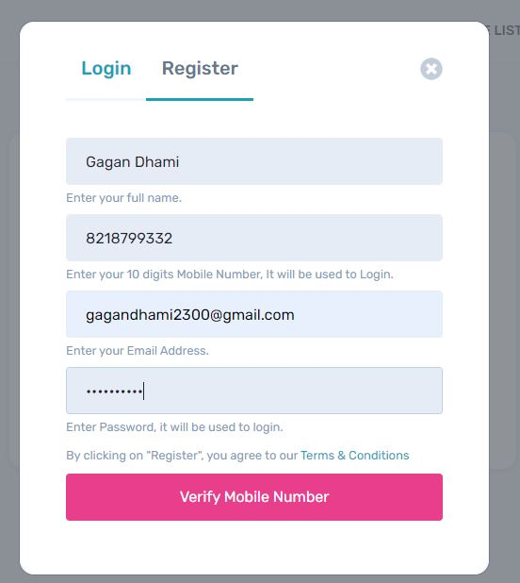
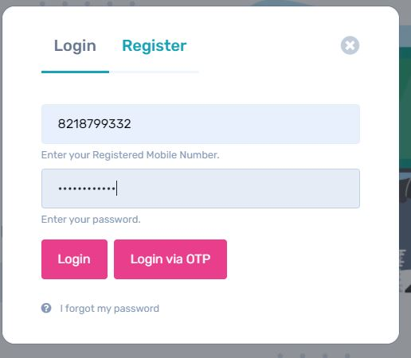
Work Accomplished:
Module 1 - Login and Register for Customer
The aim of the first module is to gather user details from the user and to store the user details and credentials in the MySQL database that lets you store and sync data between your users in real-time.

Slide 11
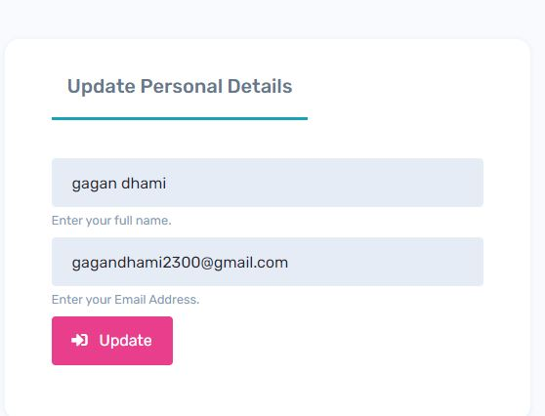
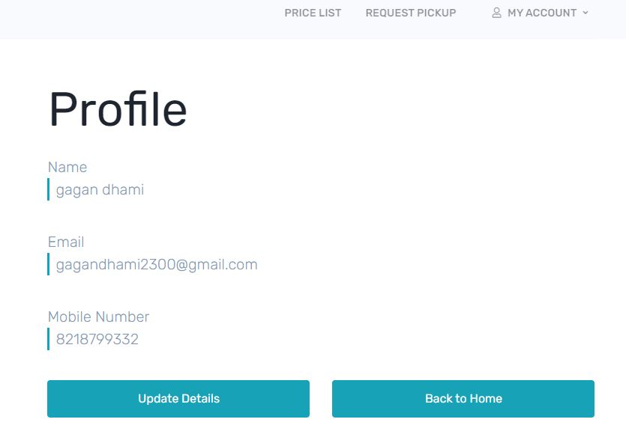
Module 2 - Create Profiles and Verification
The second module will focus on implementing customer profiles feature which will enable customer to create and modify their personalized pages i.e, profiles which will be viewed after login.

Slide 12
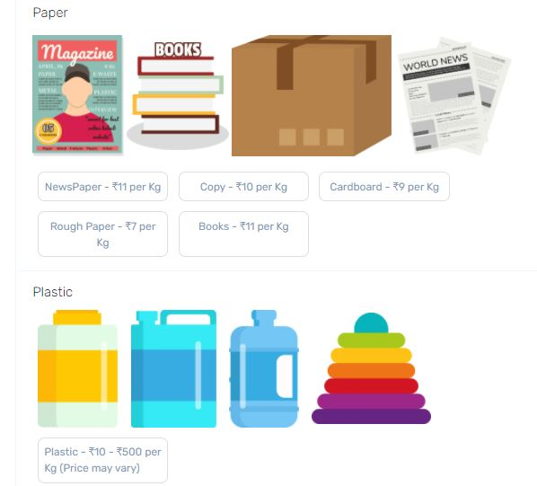
Module 3 - Scrap catalogue
This module will show customer scrap price detail. Price shown on price page are not fixed. Price may vary as per the market variation.

Slide 13
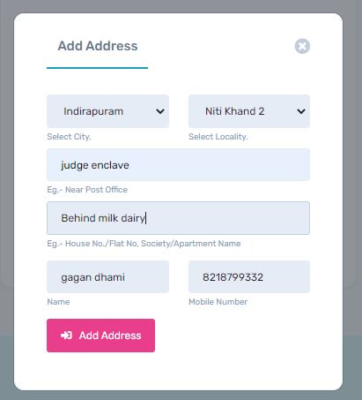
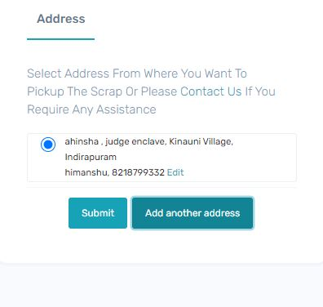
Module 4 - Request for Order
This module will help customer to request pickup and ask for the detail that customer have to provide.

Slide 14
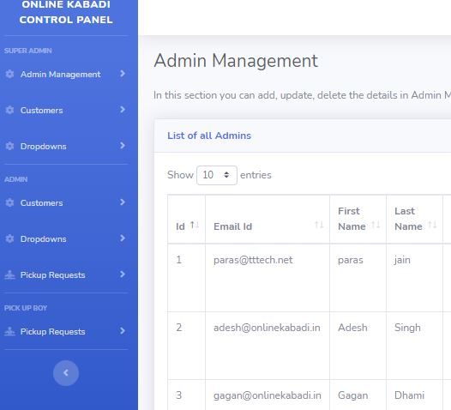
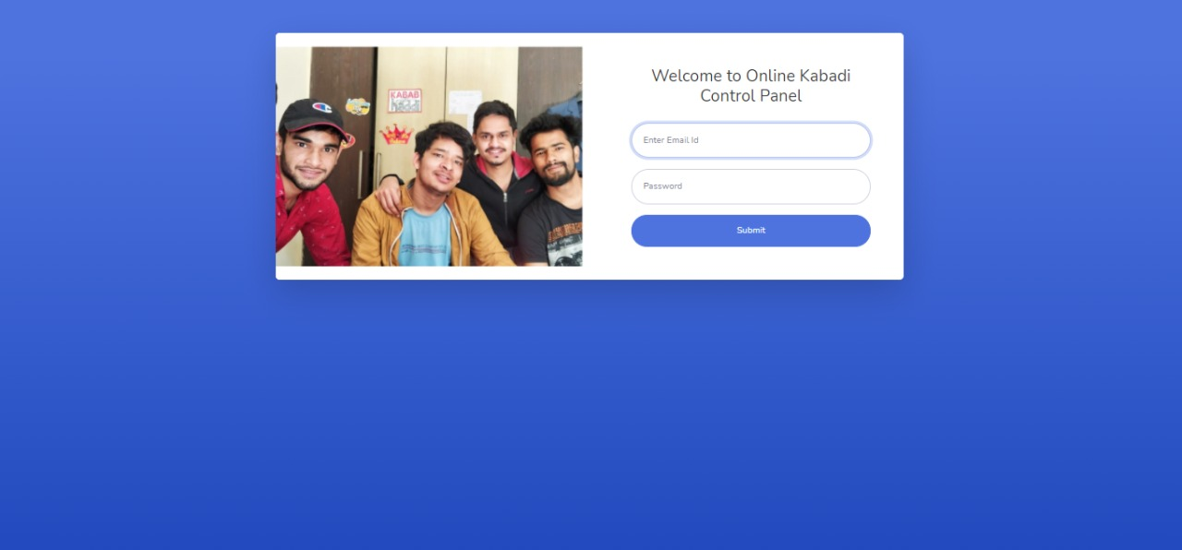
Module 5 - Control Panel
This module will have control over action of customer and admin. Using control panel we can add/remove scrap and price of each scrap.

Slide 15
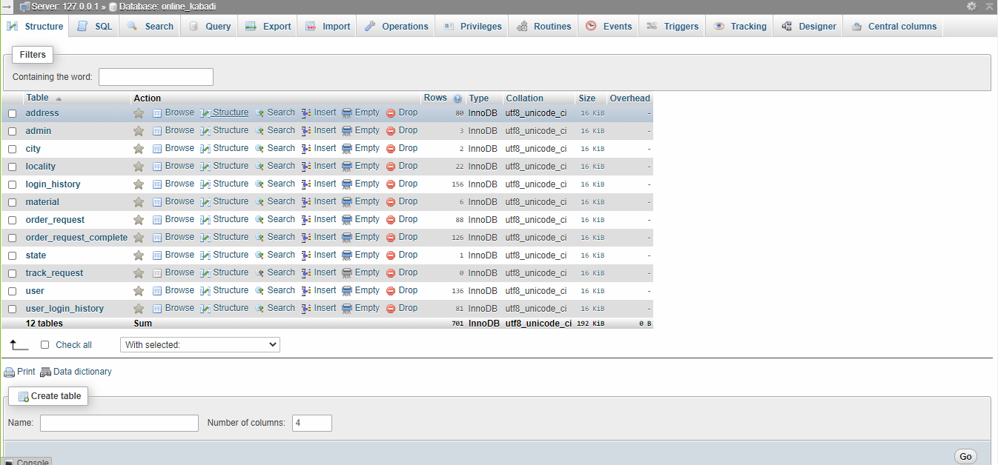
DATABASE

Slide 16
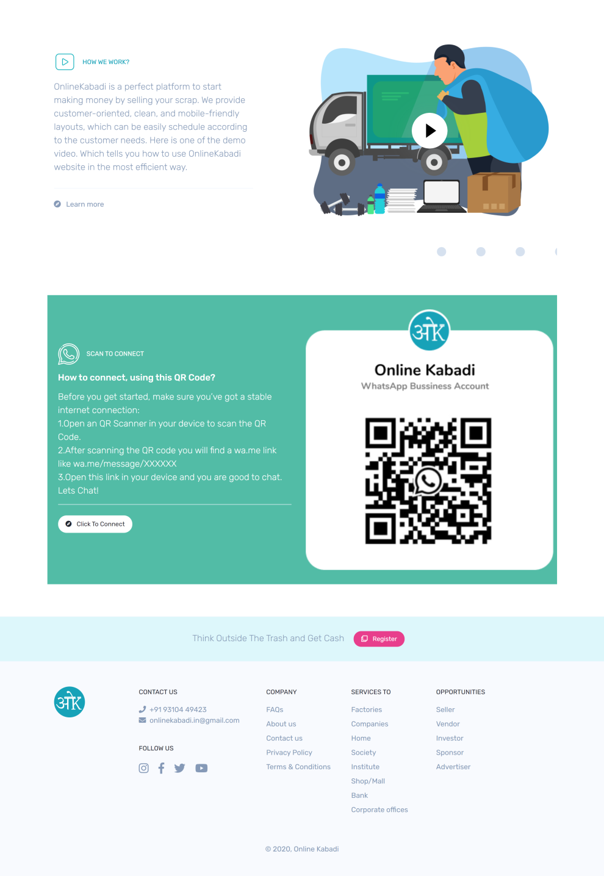

SCREENSHOTS

Slide 17
References
https://codeigniter.com/
https://getbootstrap.com/
https://themes.getbootstrap.com/
https://www.w3schools.com/js/DEFAULT.asp
https://www.w3schools.com/php/default.asp
https://www.w3schools.com/sql/default.asp

